Slide 1
Preregistration & Open Science Practices
What is it and where has it come from?
Why bother, what can I gain?
Is anyone else actually doing it?
Q & A
How do I do it? Work through an example
Other Open Science tips & tricks (e.g. Github?)
More resources

Slide 2
What is preregistration?
The replication crisis ‘began’ in Psychology… but the problems are science-wide
‘The natural selection of bad science’ is NOT about bad scientists but an outdated system with outdated incentives
Feelings that every PhD student (and scientists) can relate to….

Slide 3
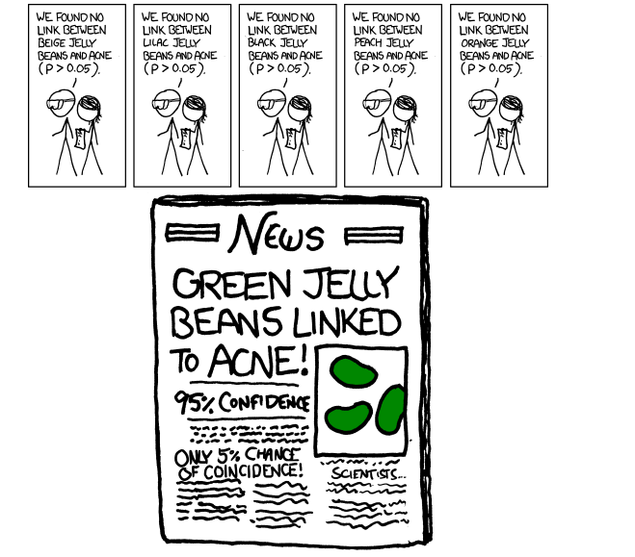
What is preregistration?
Notes:
100 studies from three high impact psychology journals from 2008 (psych sci, journal of social psy, journal of cognitive psy)
Only 36 replicated original reported effect (used same materials, contacted previous authors etc etc)
Not only that, effect sizes much smaller, and “funnel plot” of p-values of originals versus replicated
-many more reports since of “classic” or “popular psychology” findings, e.g. power pose, ego-depletion – media headlines. Bad example, seems must’ve known…
Controversy about “shaming” researchers and “stats police” …science self-correcting, now social media allows this open conversation and critique of work, data can be reanalysed etc- a good thing. Otherside is labs encouraging students to p-hack, not fraudulently, but sloppily. PhD students basing research on bogus literature- assuming they’re bad scientists when they don’t replicate the effect
What is the problem? Publication bias, p-hacking, HARKing…
How do we fix it? Surely not all scientists are liars..
One thing is open science… another is ‘metascience’ modelling the process of science itself – fave paper. Playing with parameters of false positive rates, replication rates, publication rates etc etc replication is good in separating true hypotheses from false, esp when negative replications are published…
Natural selection of bad science… can be ACCIDENT… assumes scientists have good intentions

Slide 4
Preregistration vs Registered Reports
Time-stamped, open record of your predictions, hypotheses and analysis plan
Usually (but not exclusively) before you collect your data
Is not linked to any particular journal
Peer-review is conducted on your intro, methods and analysis, before you collect the data
This is done with a specific journal who promises to publish your work as long as you follow that peer-reviewed plan

Slide 5
Why bother?
It speeds up your research
Freedom from too many degrees of freedom (and anxiety)
Confidence to explore
Gain reviewers’ trust
Be scoop-proof!
Improve the validity of science ..forever….

Slide 6
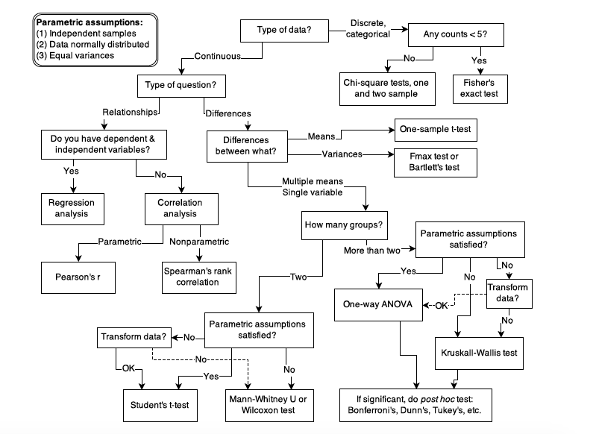
Speeds up your research!
Notes:
Have you ever been faced with a
large, complex dataset and instantly known the best way to analyse it, which parameters
to include, which random effects, how to clean and reshape the data, and the code to go
with it? Of course not- unless you’ve preregistered.
“I already plan my analysis before I collect the data….” That’s what I thought too. until you are forced to answer very detailed questions
about EXACTLY what you’re going to do, and, even better, write the analysis script and
run it with dummy data, I guarantee you have not thought of every tiny detail. Having not
preregistered anything during my PhD, I know all too well (as I’m sure most of you do)
the feeling of being faced with a dataset, and realising that not only did you overlook a
few seemingly minor things that constrain your analysis in pretty fundamental ways, but
there are also an overwhelming number of possibilities for how to analyse it to answer
your research question. Get all this out the way BEFORE see the data, make a few minor adjustments if needs be etc

Slide 7
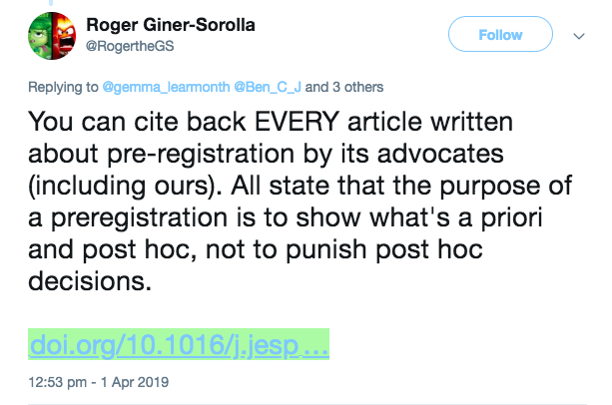
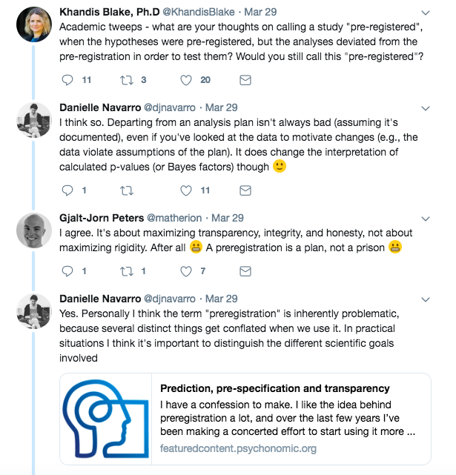
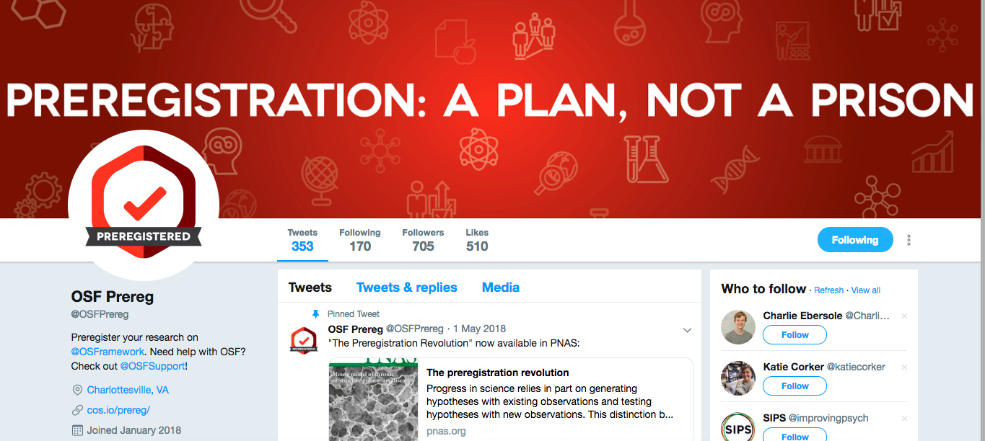
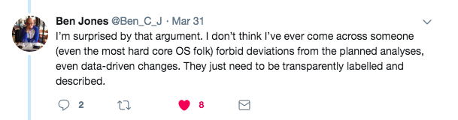
Freedom from degrees of freedom (and anxiety!)

Slide 8
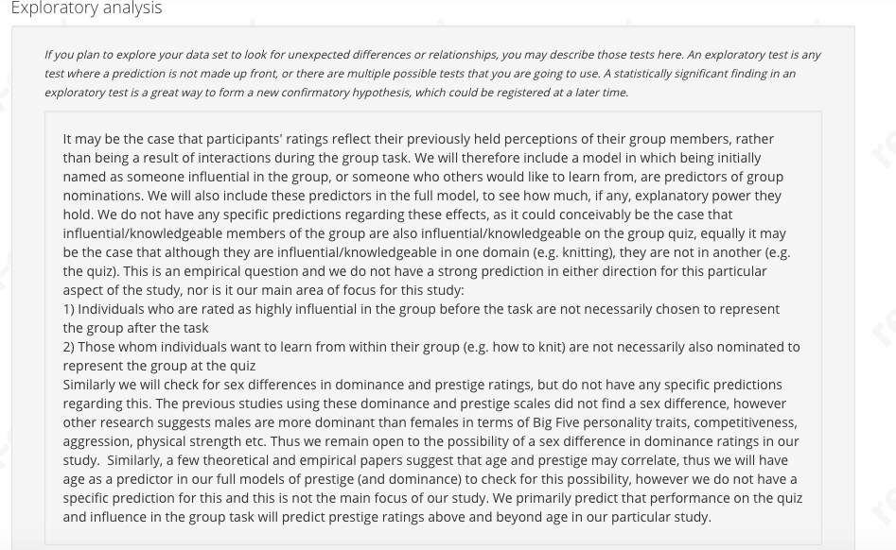
Confidence to Explore!

Slide 9
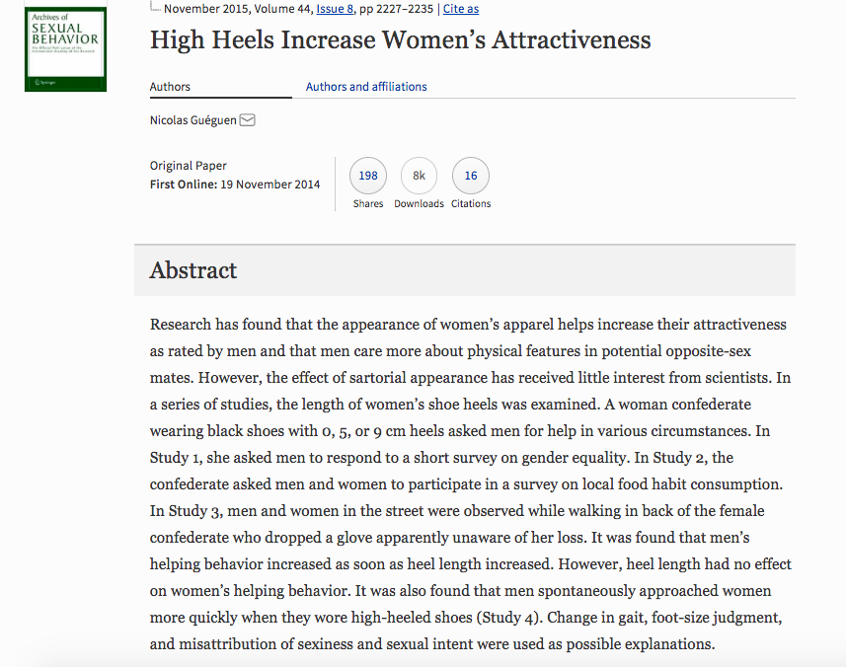
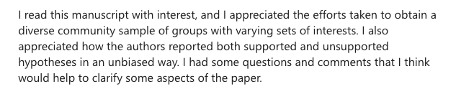
Gain reviewers’ trust!

Slide 10
Scoop Proof!
You have a jaw-droppingly unique idea- Preregister it!
Someone claims the same idea - point them to your time-stamped preregistration! If they claim they had the idea first, too bad, they should’ve preregistered it (or, you should’ve!)
If they preregistered at exactly the same time too, bond over this coincidence and turn the competition into collaboration
If they claim they genuinely didn’t see your preregistration (or you genuinely didn’t see theirs) this is just bad luck and cannot be avoided just in the real life world of people having simultaneous research ideas…. Preregistration doesn’t make this any more likely

Slide 11
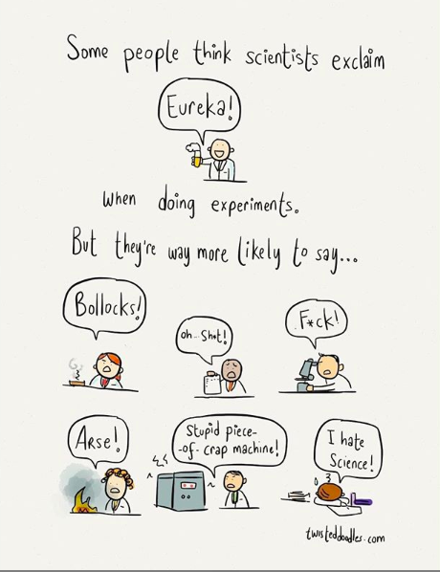
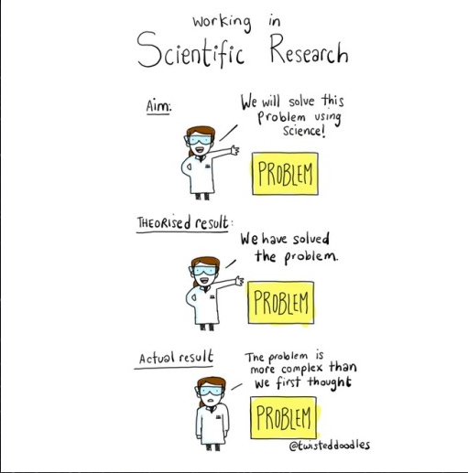
Improve validity and trust in science… forever!
Notes:
Wasted research hours on stuff that isn’t replicable
Focus on cumulative incremental findings, not black and white headline-grabbing science
Help with publication bias and more transparent, apriori based predictiosn and analysis…

Slide 12
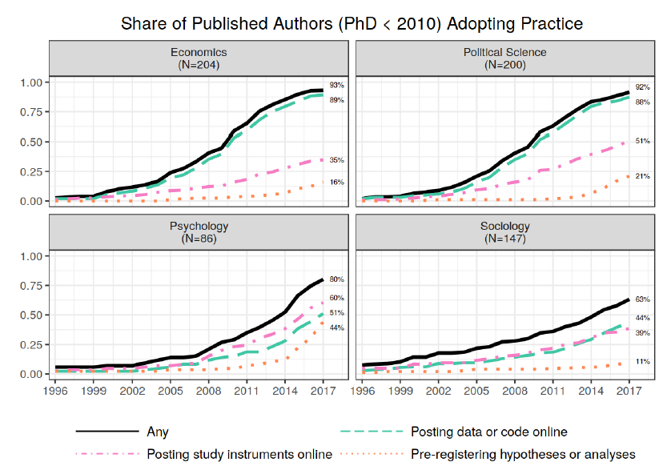
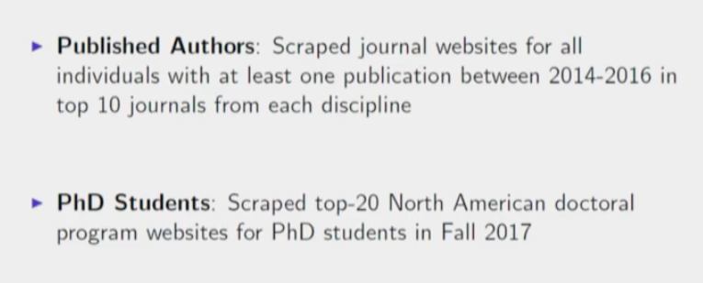
Is anyone actually doing it?
Pre-registered… obviously!
https://www.bitss.org/events/2018am/

Slide 13
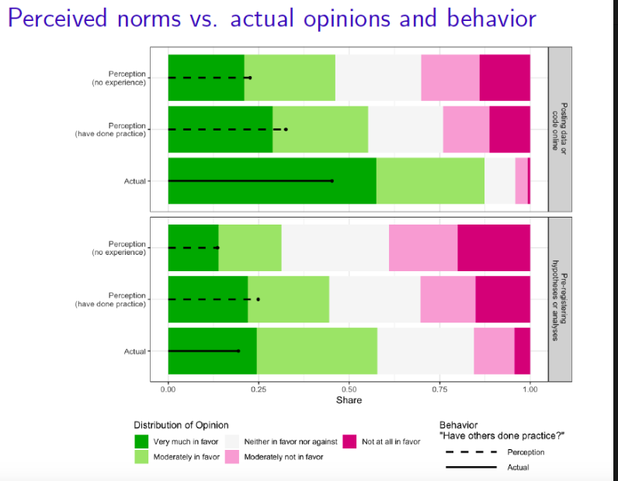
Is anyone actually doing it?
https://www.bitss.org/events/2018am/

Slide 14
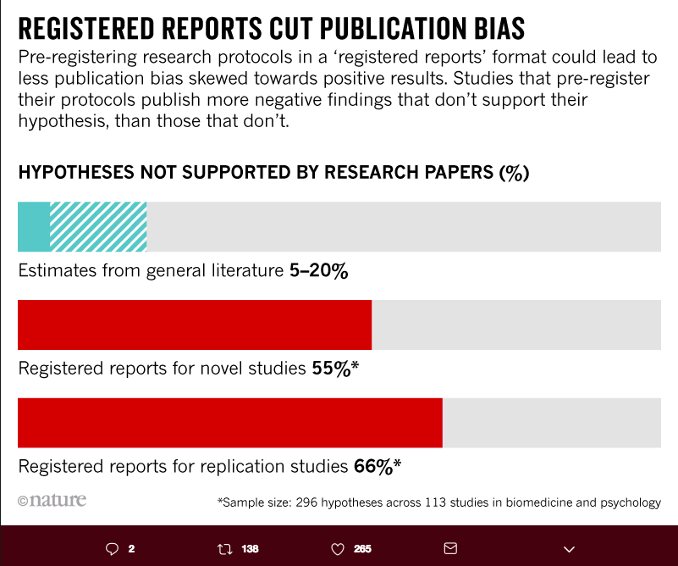
Is anyone actually doing it?
https://www.nature.com/articles/d41586-018-07118-1

Slide 15
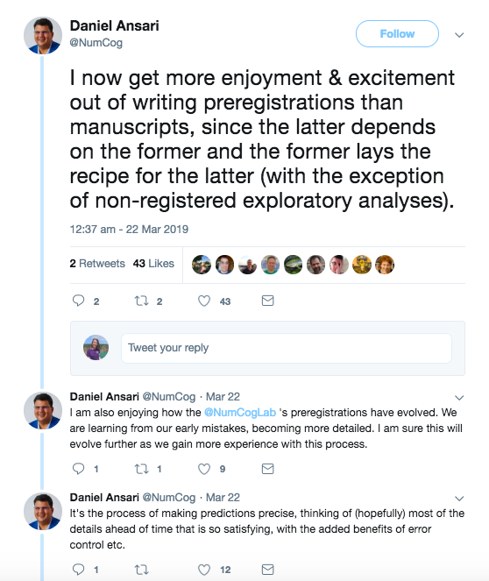
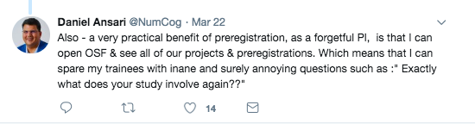
Is anyone doing it?

Slide 16
Any questions….?

Slide 17
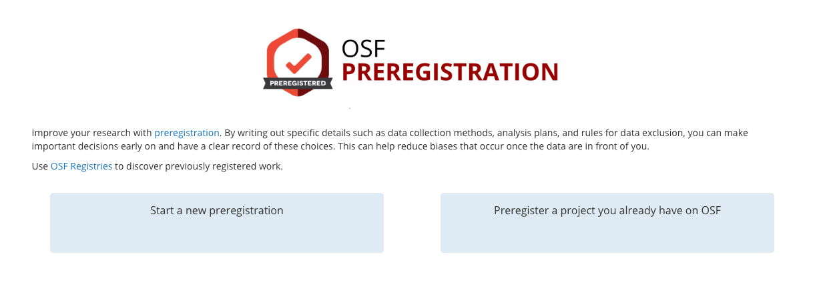
How do I do it?
https://psyarxiv.com/wte5z/ <- step by step slideshow
https://osf.io/prereg/
www.aspredicted.org
https://docs.google.com/document/d/1DaNmJEtBy04bq1l5OxS4JAscdZEkUGATURWwnBKLYxk/edit?pli=1 <- full template

Slide 18
Other Open Science tips & tricks:
OSF https://osf.io/
Preprints https://www.biorxiv.org/
Publons https://publons.com/researcher/1248054/charlotte-brand/
GitHub https://github.com/lottybrand22/Preregistration_workshop/
Access Lab: https://fo.am/activities/accesslab/
Open reviews (RSOS tab):
Ditch Elsevier:
Twitter….!!!!! @OSFprereg https://twitter.com/OSFPrereg

Slide 19
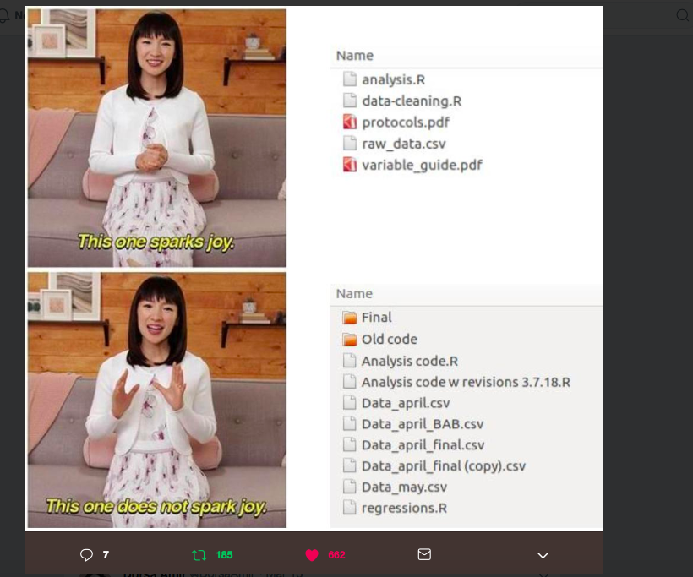
GitHub

Slide 20
Other resources
https://doi.org/10.1098/rsos.160384 The Natural Selection of Bad Science (Smaldino & McElreath 2016)
What’s happened down here is the winds have changed. Gelman 2016 https://statmodeling.stat.columbia.edu/2016/09/21/what-has-happened-down-here-is-the-winds-have-changed/
https://journals.sagepub.com/doi/full/10.1177/1745691618767878 – Open Science is Liberating and can foster Creativity (Frankenhuis & Nettle 2018)
https://osf.io/854zr/ Positive results rate in psychology: registered reports compared to conventional literature (Schijen, Scheel & Lakens 2019)
https://www.pnas.org/content/115/11/2600 The Preregistration Revolution (Nosek et al 2018)
http://www.talyarkoni.org/blog/2018/10/02/no-its-not-the-incentives-its-you/ It’s Not the Incentives, it’s You
Plea for positivity and preregistration https://lottybrand.wordpress.com/2018/10/05/a-postdocs-plea-for-positivity-preregistration/

Slide 21
Wisdom, not impact
“Some people think that what I should be doing is producing Nature and Science papers. More than one colleague has specifically asked me which “Science/Nature projects” I have planned. That is not what Max Planck Departments are for. High-profile publications may arise, but they should be side effects. We demand wisdom, not professional impact.”
Richard McElreath, director of the Department of Human Behavior, Ecology, and Culture at the Max Planck Institute for Evolutionary Anthropology http://elevanth.org/blog/2018/09/02/golden_eggs/

